Slide 1

CS 470 Project Two Conference Presentation: Cloud Development
[Matthew Knutson]
[December 2024]

Slide 2
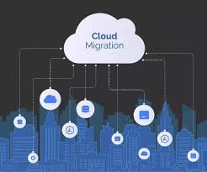
Overview
My name is Matt Knutson.
I AM a computer science major from Galveston, TX.
We will learn how to move a locally hosted application into the cloud.
This project will use the AWS Cloud Architecture.
AWS Services: S3, API Gateway, Lambda, & DynamoDB.
Notes:
Hello, everyone. My name is Matt Knutson. I am a computer science major at SNHU and I currently live in Galveston, TX. The purpose of this presentation is to explain how to move a locally hosted MEAN application into a cloud environment. This project will use the AWS Cloud Architecture, and it will take advantage of several of Amazon’s Microservices. The Services we will use to build the cloud’s infrastructure will replace each element used in the MEAN Stack. The MEAN Stack originally consists of MongoDB as the database, Express.js & Node.js as the back-end, & Angular as the front-end, or client side. Each microservice we use will provide the same functionality in the cloud as it’s local counterpart. The AWS S3 service will replace Angular on the front-end, AWS API Gateway & Lambda will replace Express & Node.js on the back-end, and DynamoDB will now be our cloud native database.

Slide 3
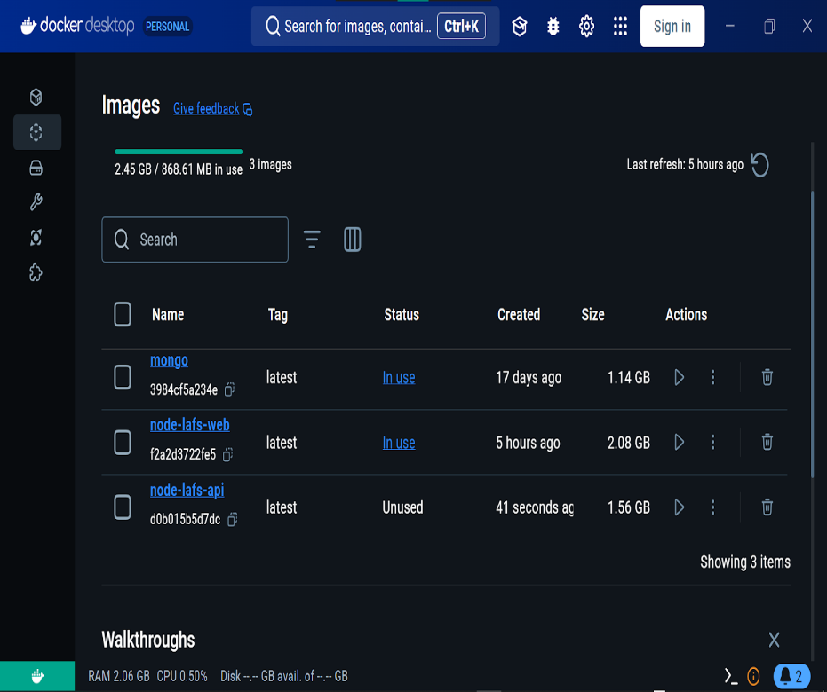
Containerization
Necessary Tools: Docker, The Command Line, & Docker Commands.
Separate the application into a front-end, back-end, and database.
Each component will become a Docker Image, or Container.
Notes:
To get started, the front-end, back-end, and database will need to be separated and Containerized in an application called Docker. By using Docker commands in the command prompt, images will be created for each of the necessary components for the application.

Slide 4
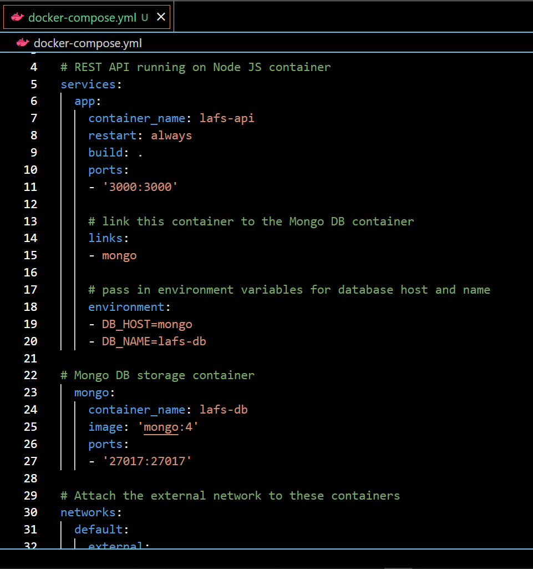
Orchestration
The YAML file consolidates the start-up code for each container.
With one line of code, the entire stack of images can be brought online.
Notes:
When multiple Containers will be used to build an application, Docker allows the developer to consolidate these images into a Docker Compose file. This file is called a YAML file, and with one line of code, all of the containers for the application can be run consecutively. A Network Bridge is responsible for communication between containers within the Docker Composition.

Slide 5
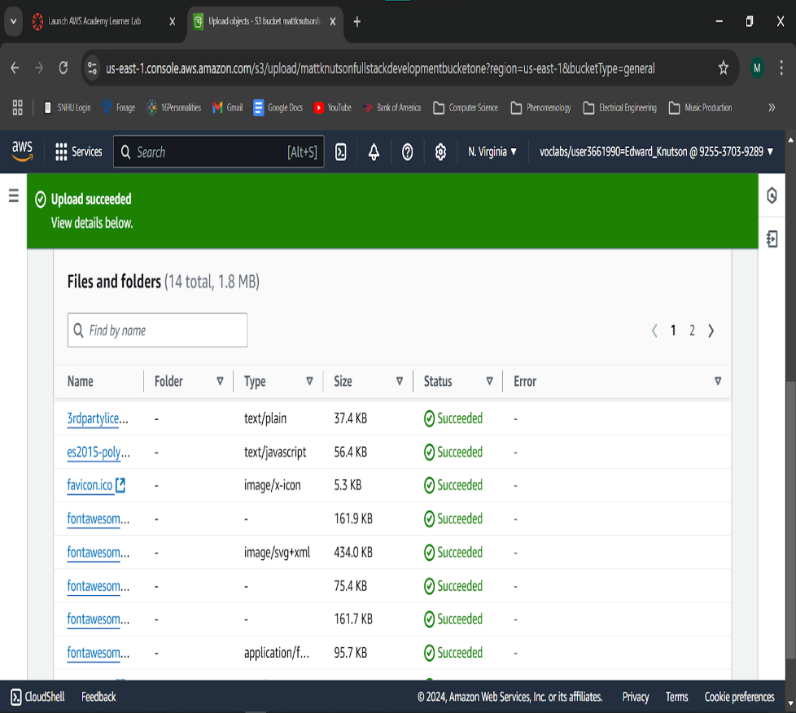
The Serverless Cloud
Serverless
Serverless: I AM not responsible for maintaining server hardware or security.
Highly scalable.
Event-driven architectures & pay-as-you-go services.
S3: Store your application data in Buckets of 100tb.
Notes:
The term serverless refers to a scenario where the developer of an application is not responsible for maintaining and securing the physical hardware that the system runs on. Instead, the cloud provider manages all the server’s hardware and keeps it secure. A serverless infrastructure is also highly scalable due to its access to a virtually unlimited amount of storage. The serverless cloud also offers event-driven architectures & pay-as-you-go services, where the customer is only charged for the time and resources they use. This greatly reduces the cost of physically adding storage to a system and managing local servers. AWS S3 is cloud-based, virtual storage service that is very similar to the local storage on a personal device. While each Bucket will hold 100tb of data, accessing more storage on S3 is as simple as purchasing another bucket. This is a much simpler process than the classic example of adding a new hard drive to a personal laptop or PC.

Slide 6
The Serverless Cloud
API & Lambda
API Gateway makes it very simple to create, publish, maintain, test, & secure APIs.
API Gateway routes the REST methods to the correct Lambda function.
Lambda uses triggers to activate program logic. This is also known as FAAS (Function-as-a-Service).
Notes:
API Gateway and Lambda make up the serverless back-end of our application. API Gateway not only allows the developer to create, publish, maintain, test, & secure an API, it also acts as a centralized storage for all the APIs in use. API Gateway is also responsible for routing the REST methods (Create, Read, Update, Delete, and Post) to the correct Lambda functions. The Lambda functions are then triggered by changes in data, shifts in the system’s state, and actions by users.

Slide 7
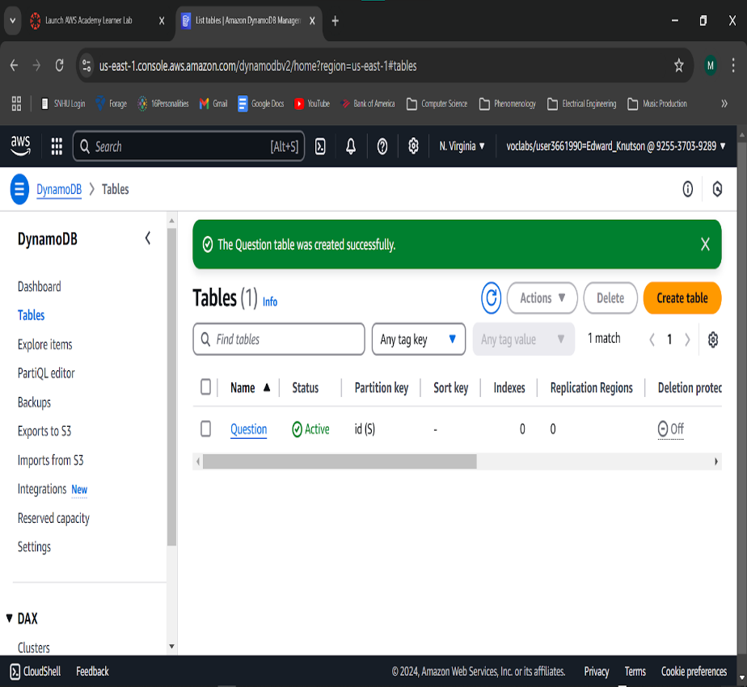
The Serverless Cloud
Database
MongoDB and DynamoDB are both NoSQL databases.
MongoDB is a local database and can be set up any device.
DynamoDB is strictly a cloud-based database.
DynamoDB uses a single-table design to query data.
Notes:
The final piece to the puzzle, is the database. While MongoDB & DynamoDB are both NoSQL databases, they have a couple distinctive characteristics. MongoDB is a local database that is keep on a physical device or server. DynamoDB on the other hand, is strictly a cloud-based database which can be accessed anywhere on the internet with proper authorization. DynamoDB also utilizes a single-table design to query data. Unlike MongoDB, where data is stored as key-value pairs in collections, DynamoDB’s single-table design stores data in entire blocks. These blocks are then partitioned using a partition-key. In DynamoDB, a sort-key can be combined with a partition-key to create a Composite Primary Key. This primary key is then used to quickly recover data collections from the database.

Slide 8
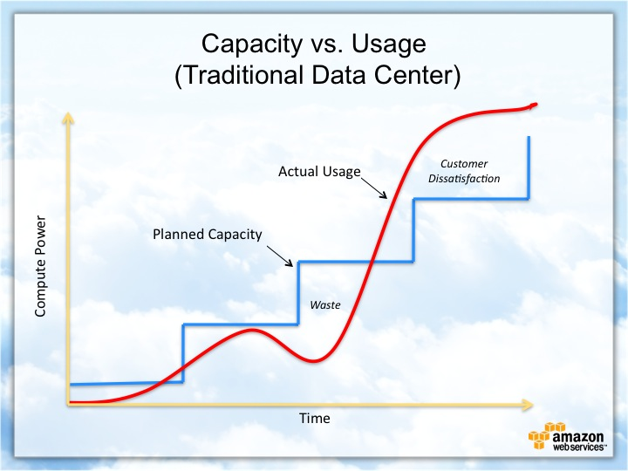
Cloud-Based Development Principles
Serverless
Elasticity
Pay-for-use model
Highly scalable
Use of microservices
Notes:
As we have seen from the previous slides, moving to the cloud is relatively simple and yet it comes with many advantages for the client. The serverless model provides elasticity for an application’s user traffic, allowing it to easily scale up, or down, based on usage. The pay-as-you-go model keeps the client from investing heavily in resources they won’t need and gives them access to unlimited resources should they need them. And using microservices keeps the development process much simpler than building from the ground up.

Slide 9
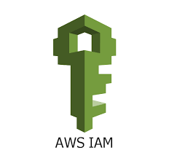
Securing Your Cloud App
Access
AWS IAM (Identity & Access Management) is a centralized security service.
IAM stores the roles and their policies for each application.
IAM checks for access & authorization as a user moves through each service.
Notes:
AWS Identity & Access Management, or IAM, is Amazon’s centralized security service. This service is used to create and store roles and is responsible for enforcing security throughout the entire system. IAM checks for access and authorization each time a role-based user moves from one service to another.

Slide 10
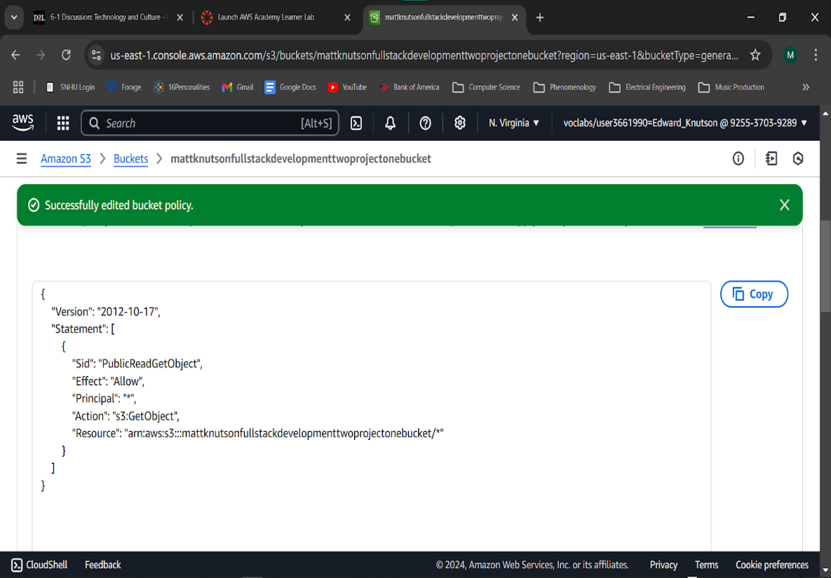
Securing Your Cloud App
Policies
Roles are made up of different policies.
Users are assigned to those roles.
User’s actions within the system are limited by those policies.
The Admin Role was used for back-end access & privileges.
Notes:
Policies are permissions that are granted to a user. A role is a collection of policies that dictate what that role can do within the systems framework. Rather than assigning policies to every user, users can simply be added to roles where the policies are already set in stone. By using roles, access and authorization are strictly enforced throughout the application. For example, the Admin role in this project can Create, Read, Update, and Delete data from the database, while the average user can only Read information from the website.

Slide 11
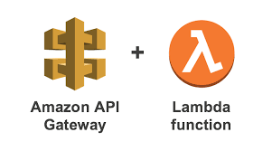
Securing Your Cloud App
API Security
Always use an API Key for a secure connection.
IAM ensures that a there is a secure connection between every service.
Notes:
To apply security measures to your API Gateway on AWS, all the developer needs to do is initialize an API Key. This can easily be automated when each API is created. Once a key has been put in place, access will be denied to users who don’t posses the key. This type of security measure can be added to each layer of services, adding multiple layers of secure connections.

Slide 12
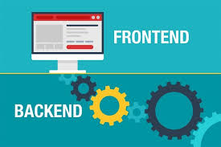

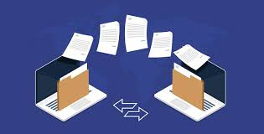
Conclusion
Separate your Front-End & Back-End into Containers.
Migrate your Database into the cloud.
Implement IAM security throughout the system.
Update & manage your applications.
Notes:
So, there you have it! A brief overview of the tools and services needed to move a MEAN Stacked application from a local server to the AWS Cloud. First, you merely separate your front-end, back-end, and database into Containers. Use Docker to Compose your Containers into a working, cloud-based application, and then migrate your local data into the cloud’s database. Make sure you are implementing IAM security measures throughout your system. Finally, create, update, and manage your applications without the hassle of server and hardware overhead. Thank you very much for your time and it has been a pleasure speaking here today.

